Slide 1

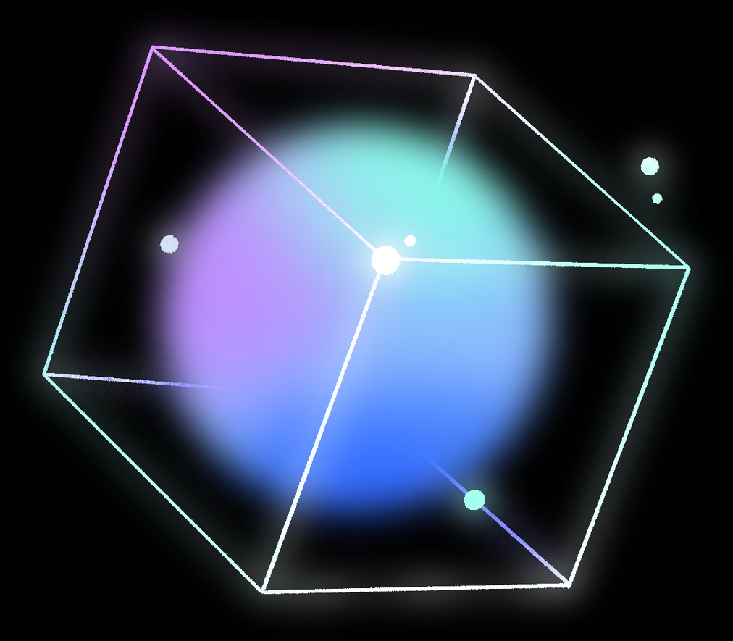




Neural Networks
PROJECT

Slide 2

INTRODUCTION
The Handwritten Digit Recognition project is an intriguing application of neural network techniques in the field of machine learning. The aim of this project is to build a model capable of accurately identifying handwritten digits from images. We will utilize the MNIST dataset, a well-known dataset containing images of handwritten digits along with their corresponding labels. Our task involves training a neural network model using these images and then evaluating the model's performance on the test data. This project provides an excellent opportunity to explore the capabilities of machine learning in pattern recognition and solve real-world problems across various domains.

Slide 3


MACHINE LEARNING
In the Handwritten Digit Recognition project, the role of machine learning is pivotal in developing a model capable of accurately recognizing handwritten digits. Here's how machine learning contributes to this project:
Digit Classification: The project involves classifying images containing handwritten digits into their corresponding numerical values (0-9). This task is challenging as it requires distinguishing between similar digits and recognizing unique patterns for each digit.
Model Learning: The model is trained using the training data of handwritten digits. It learns the distinctive patterns and features of each digit by analyzing the images and iteratively refining its parameters during training.
Digit Recognition: After training, the model applies its learned parameters to perform recognition on new unseen images. It utilizes the learned patterns to make decisions about the handwritten digits in the new images.
.

Slide 4

Activation function
01
02
03
04
ReLU (Rectified Linear Unit):
. Used in the first two layer
. ReLU function transforms negative values to zero while keeping positive values unchanged.
. It accelerates the learning process and reduces the likelihood of the vanishing gradient problem.
Sigmoid:
. Used in third layer
. Sigmoid function transforms values to a range between 0 and 1.
It is used to regulate the flow of information in the model and output a probability distribution
Tanh (Hyperbolic Tangent):
. Used in fourth layer
Tanh function transforms values to a range between -1 and 1.
It contributes to improving the model's stability and increasing its learning capacity
Softmax:
.Used in final layer
.Softmax function transforms the results into a probability distribution, facilitating the final decision-making regarding classification
:

Slide 5



Algorithm

Slide 6

Multilayer perceptron (MLP)
The model utilizes a Multilayer Perceptron (MLP) for recognizing handwritten digits. MLP is a type of neural network with multiple layers of computational units called perceptrons. It's trained using the backpropagation algorithm to adjust the connections between layers :
Input Layer: Receives input data, such as images of handwritten digits.
Hidden Layers: Process the input data, extracting features and patterns.
Output Layer: Generates predictions for the handwritten digits.
During training, the MLP learns from pairs of images and their correct labels. The weights between layers are adjusted to improve the model's accuracy in predicting digits.
MLPs are widely used for classification tasks and are foundational in machine learning applications.

Slide 7



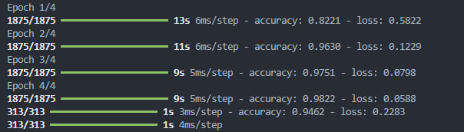

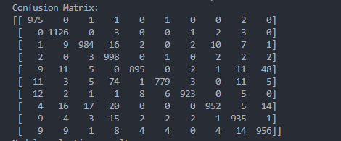
ACCURCY AND CONFUSION MATRIX
01
02

Slide 8
Project Team
1- Abdelrahman salah Elazab
2-Zeyad Mohamed Elwasef
3- Zeyad Ahmed Eldesokey
4- Mohamed Yousef Harb

Slide 9

THANK YOU!

